Slide 1
Bất đồng bộ Javascript

Slide 2
Javascript là ngôn ngữ đơn luồng (Single Thread)

Slide 3
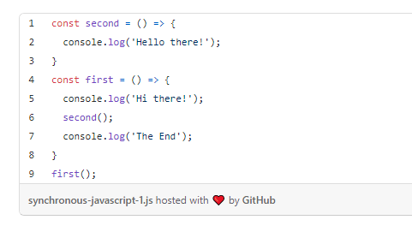
Execution Context
Callstack

Slide 4
Execution Context
CallStack

Slide 5
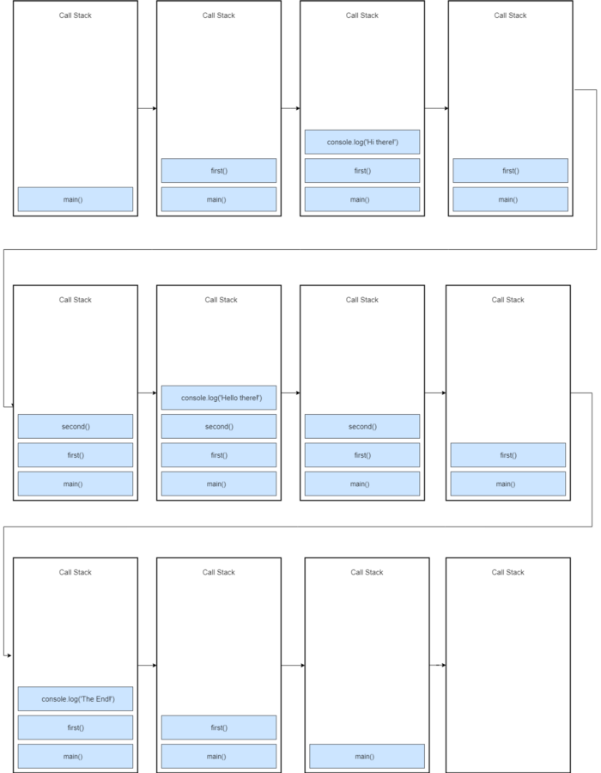

Slide 6
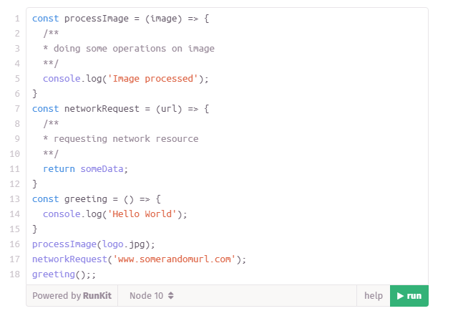
Blocking

Slide 7
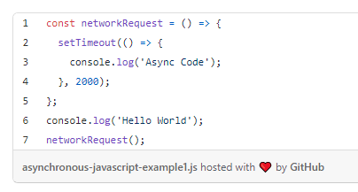
Blocking

Slide 8
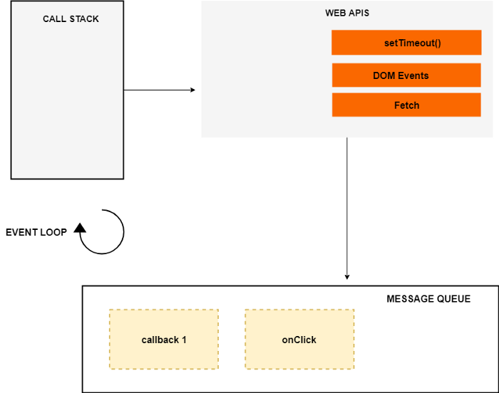
Event loop
Message queue
WEB API
Dom Events

Slide 9
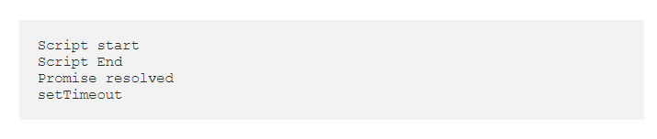
Job Queue/ Micro-Task Queue

